Slide 1
Khabar Bekhabar
News Feed Application
BY:
Nidheesh Panchal (2016UCP1008)
Vandita Goyal (2016UCP1004)

Slide 2
Features Implemented
Khabar Bekhabar is a desktop application which provides an easy method to stay up-to-date with all the happenings in the world. It provides the following features:
Password protected accounts
The main page displays the latest news according to the preferences of categories and location
User can search for news article using a particular keyword or a set of keywords – can be sorted on the basis of relevancy, popularity and date
User can edit his/her location and preferences to change the newsfeed
User can read the articles further by clicking on the description provided

Slide 3
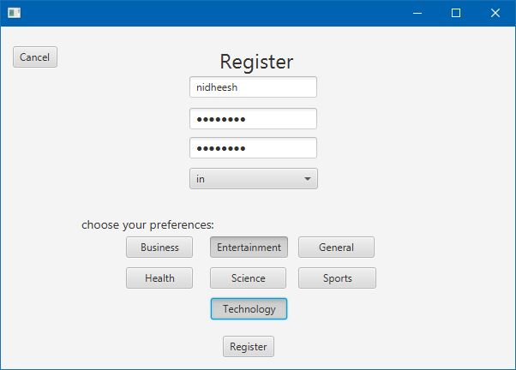
Registration
Takes the user’s username, password, country and preferences and stores in a database

Slide 4
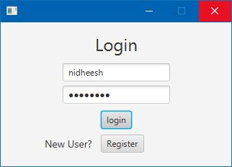
Login
Login using database

Slide 5
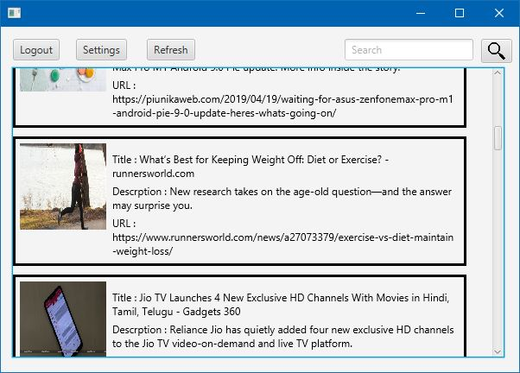
News Feed
Display News on the basis of the category preference provided by the user

Slide 6
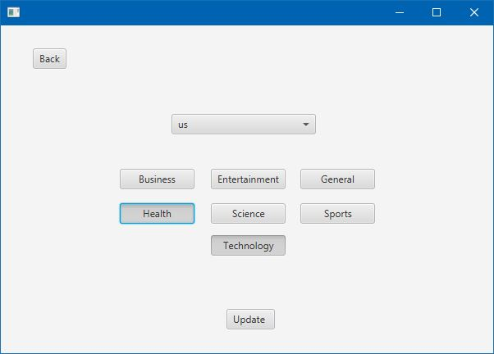
Update Settings
Updating settings – changing country and category preference

Slide 7
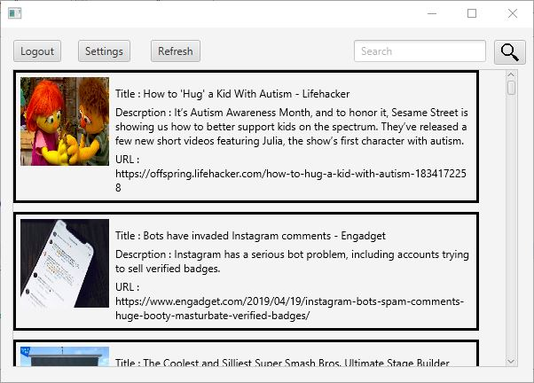
Update Settings (contd.)
New news feed on the main page according to the updated settings

Slide 8
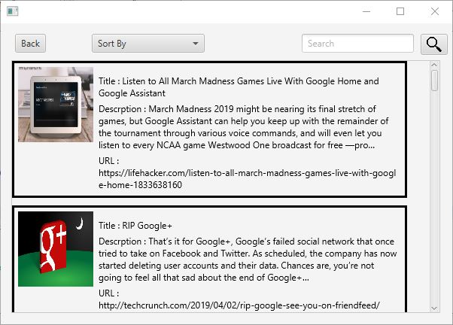
Search Page
Articles provided on the basis of the keyword or set of keywords given by the user (Sorted by relevancy)

Slide 9
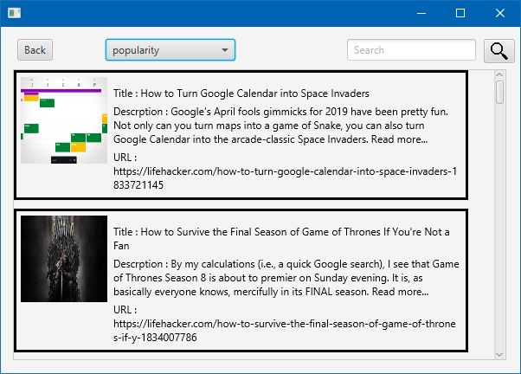
Search Page (contd.)
Articles provided on the basis of the Keyword or set of keywords provided by the user sorted on the basis of popularity as chosen by the user

Slide 10
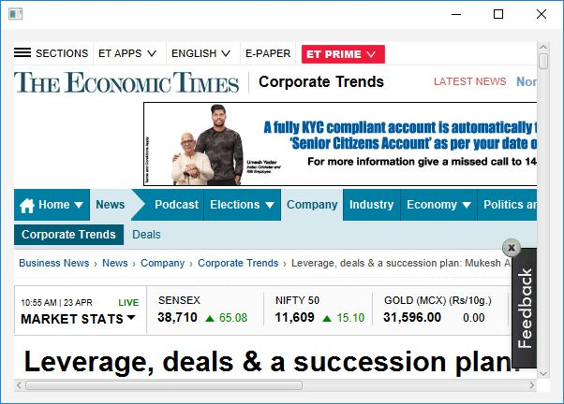
Web View
Users can read more about the article by clicking the description.

Slide 11
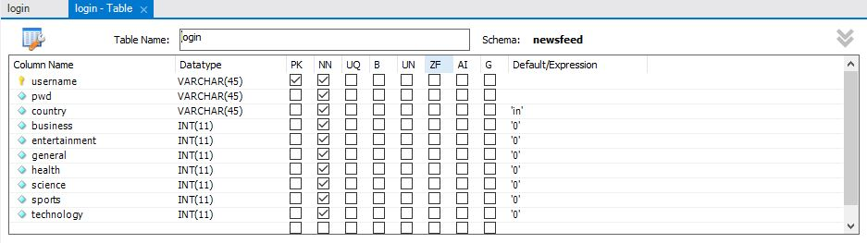
Database
Database for Login and Registration. It is used to store location and category preferences corresponding to every user.

Slide 12
Software used for Development
Graphic User Interface Development: JavaFX
API to provide the information (news): News API
Database Server : MySQL
Tool used to create database: MySQL Workbench 8.0
Tool used for GUI development: NetBeans IDE 8.2

